Slide 1
Time-Series Forecasting with Auto encoders
SUBMITTED BY
AUXSHILIA S
NM ID: au711721104021
KGiSL INSTITUTE OF TECHNOLOGY
3/21/2024 Annual Review

Slide 2
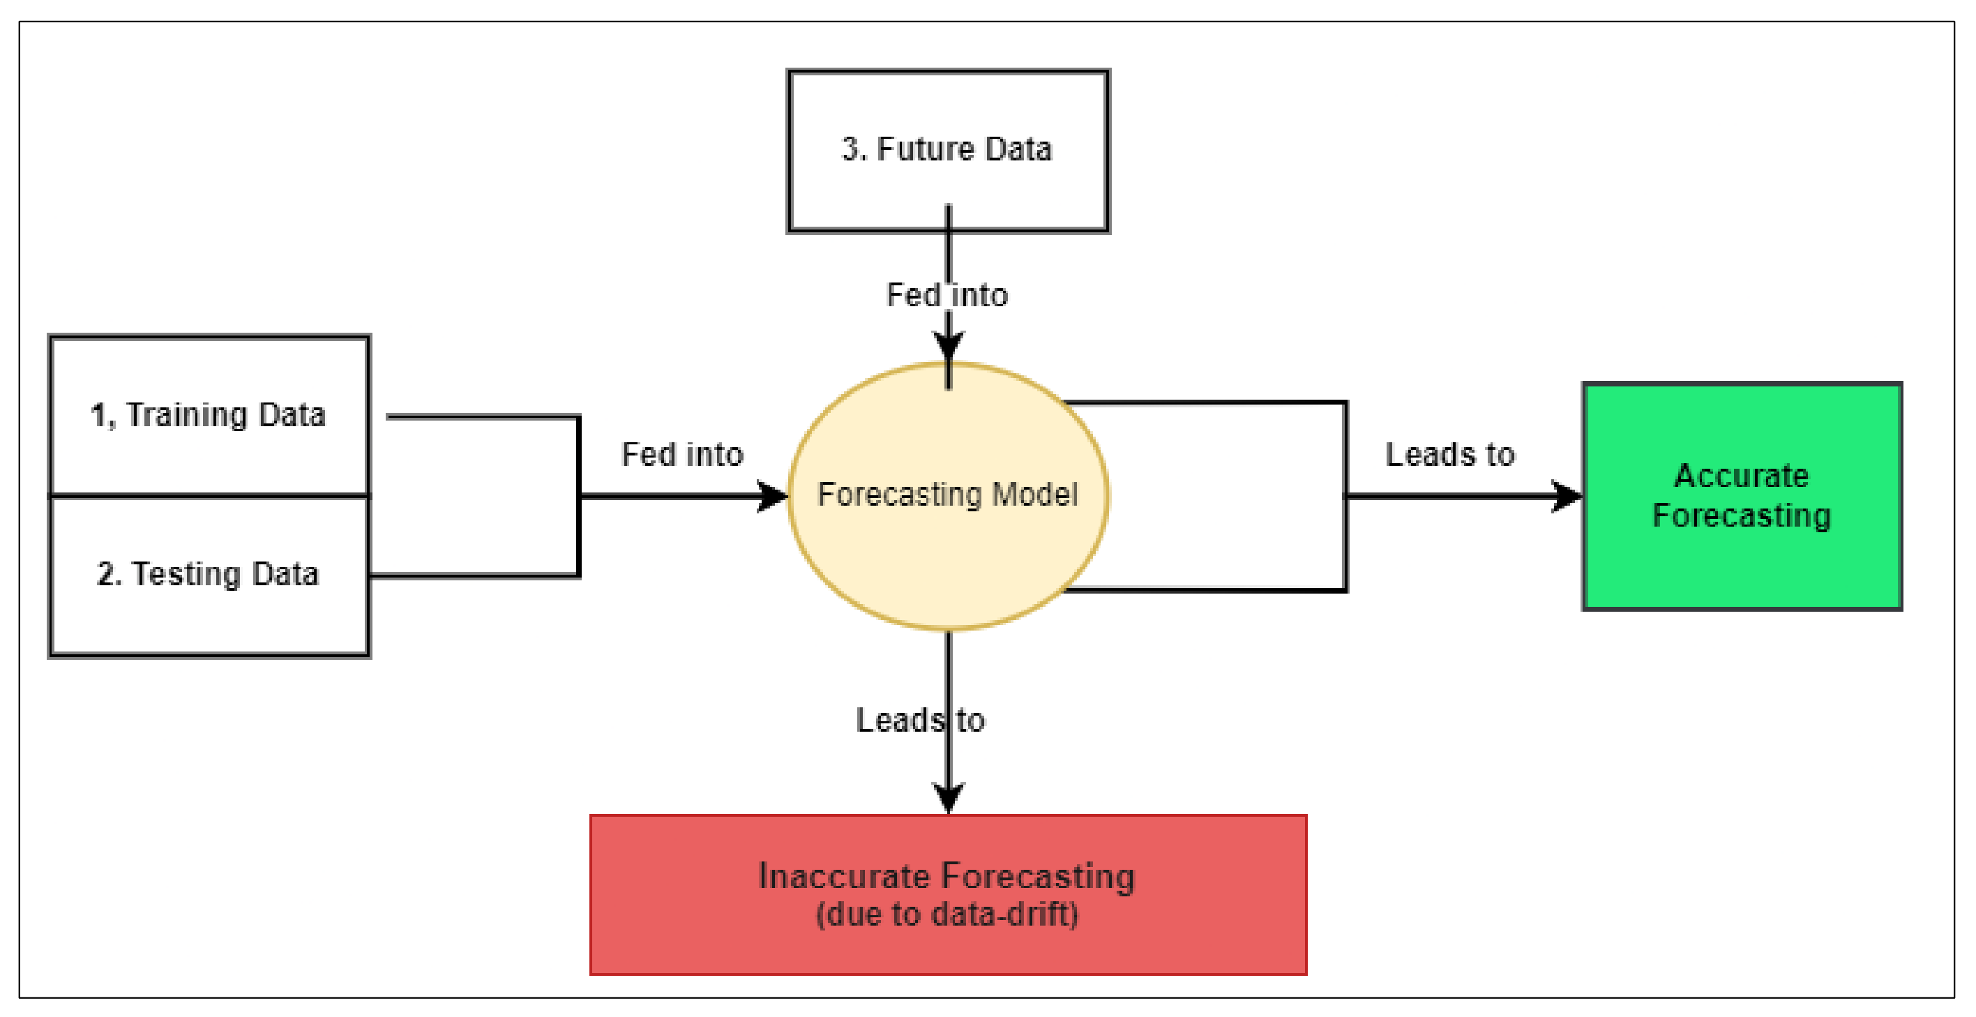
Time-Series Forecasting with Auto encoders
3/21/2024 Annual Review

Slide 3


AGENDA
PROBLEM STATEMENT
PROJECT OVERVIEW
END USERS
SOLUTION AND PROPOSITION
KEY FEATURES
MODELLING APPROACH
RESULT
3/21/2024 Annual Review

Slide 4

PROBLEM STATEMENT
Develop an autoencoder-based approach for time-series forecasting to accurately predict future data points by capturing temporal dependencies and patterns within dynamic and evolving datasets.
Design and train an autoencoder architecture, exploring variations such as RNNs, LSTMs, and CNNs, to encode input time-series data and reconstruct the original sequence, adapting to changes in data distributions over time for robust forecasting.
3/21/2024 Annual Review

Slide 5

PROJECT OVERVIEW
This project aims to leverage autoencoders for time-series forecasting, focusing on capturing intricate temporal patterns within sequential data to facilitate accurate predictions of future values, thereby offering insights into upcoming trends and behaviors.
By employing autoencoders, the project seeks to develop a model capable of encoding and decoding time-series data, enabling the extraction of salient features and patterns for precise forecasting of future values, thus enhancing decision-making processes and strategic planning efforts.
3/21/2024 Annual Review

Slide 6

WHO ARE THE END USERS?
For Financial Analysts:The autoencoder-based time-series forecasting model enables financial analysts to identify subtle patterns and trends in stock prices, currency exchange rates, and other financial metrics, facilitating more accurate predictions and informed investment decisions.
For Energy Sector Professionals:By utilizing the autoencoder-based time-series forecasting model, energy sector professionals can anticipate fluctuations in energy demand, optimize production schedules, and allocate resources efficiently, leading to enhanced operational efficiency and sustainability in energy consumption and production.
3/21/2024 Annual Review

Slide 7

YOUR SOLUTION AND ITS VALUE PROPOSITION
The project's focal point revolves around leveraging autoencoder models to capture temporal patterns within synthetic time-series data, thereby enabling accurate predictions of future values across domains such as finance, energy, and healthcare, thereby facilitating informed decision-making processes.
3/21/2024 Annual Review

Slide 8
THE WOW IN YOUR SOLUTION
Autoencoder technology enables accurate forecasting by learning from sequential data.
It improves understanding of complex temporal dynamics, leading to better predictions.
Decision-making in various domains benefits from insights into future trends.
The approach enhances forecast accuracy, scalability, and interpretability for practical applications.
3/21/2024 Annual Review

Slide 9
MODELLING
AUTOENCODER MODEL:
The autoencoder model utilizes LSTM layers to process sequential data.
It encodes input sequences into lower-dimensional representations.
These representations are then decoded back to the original sequence.
Through training to minimize mean squared error loss, the model learns to reconstruct input sequences effectively capturing temporal patterns.
SEQUENCE GENERATION MODEL:
A separate function generates future data sequences post-autoencoder training.
It predicts the next data point by iteratively using the previous one.
This process captures temporal dependencies, enabling accurate forecasting.
3/21/2024 Annual Review

Slide 10
DATA GENERATION:
Synthetic time-series data is created by combining two sine waves with random noise through the "generate_time_series_data" function.
2. MODEL CREATION AND TRAINING:
The autoencoder model is built using LSTM layers as defined in the "create_autoencoder" function.
Training the model on synthetic time-series data occurs via the "train_autoencoder" function, focusing on minimizing mean squared error loss between input and output sequences.
3. SEQUENCE GENERATION:
The "generate_new_sequence" function generates future data points after the autoencoder's training.
It utilizes a seed sequence to predict subsequent data points based on learned patterns from the autoencoder model.
4. VISUALIZATION:
In the final step, Matplotlib is utilized to plot both the original seed sequence and the generated future sequence for comparison.

Slide 11
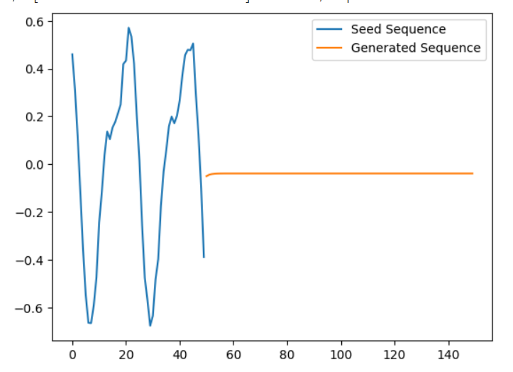
RESULTS
The project's results demonstrate the autoencoder's ability to accurately forecast future values in time-series data, showcasing its effectiveness in capturing temporal patterns and generating precise predictions.
https://drive.google.com/file/d/1E2lLc1FGSRKmYAylv0-BC-nsH2qHvzf7/view?usp=sharing
3/21/2024 Annual Review

